Slide 1
Contents
Introduction
Model Architecture
Building NN PA
Various Models Results
Conclusion

Slide 2
Introduction
  Problem Statement:
  Power Amplifier cause non-linearities near saturation.
  Digital Pre Distorter(DPD) is used to compensate the non linearities.
  A Neural Network (NN) based DPD can adapt to the changes in the PA function.
  Training such DPD is time consuming and resource heavy.
  The project helps solve the problem by creating a NN PA behavioural model which simulates the physical PA and aids in training the NN based DPD.
  Project Scope:
  Create a NN based PA model which aptly simulates real PA behavior.
  Compare various deep learning DPD models on previously created PA model.
  Identify the best model based on EVM, NMSE and ACPR values.
  Provide insights for practical applications for different PA conditions.

Slide 3
Model Architecture
I/P
Linear signal
NN DPD
Pre-Distorted signal
Physical PA
(distorts again)
Linear Amplified
O/P
A digital pre-distortion model that learns the inverse characteristics of the PA.
PPA characteristics may vary with aging, temperature, and operating point.
s may vary with aging, temperature, and operating point.

Slide 4
Building NN PA
Neural Network–Based Power Amplifier (NN-PA)
The NN-PA is a data-driven surrogate model used to emulate a nonlinear power amplifier with memory effects.
Input features consist of I/Q samples along with delayed memory taps, enabling the model to learn dynamic PA behavior.
A deep feed forward neural network maps input features to distorted output I/Q samples, implicitly learning AM-AM and AM-PM nonlinearities.
The model is trained using supervised learning on input–output data generated from a physical PA model.
After training, the NN-PA is kept fixed and acts as the nonlinear plant for all DPD experiments.
This ensures a fair and controlled comparison of different DPD architectures (MLP, RNN, GRU, LSTM) under identical PA conditions.
Physical PA
tx
rx
NN PA
Physical PA input and output used for NN PA training.

Slide 5
Model Architecture
I/P
NN DPD
Physical
PA
O/P
TRAIN
NN PA
Physical PA behavior simulated by NN PA for training DPD NN

Slide 6
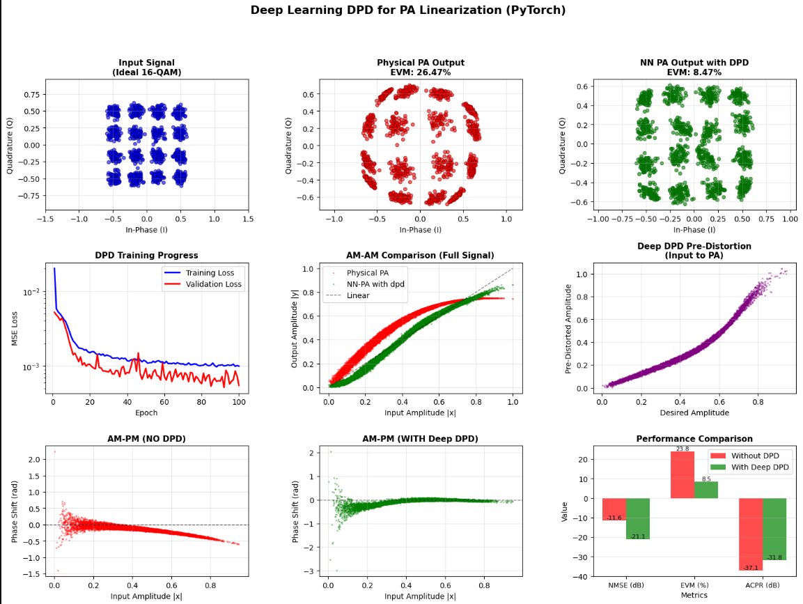
RNN
IMPROVEMENT
NMSE Improvement: 10.50 dB
EVM Improvement: 18.00 %
ACPR Improvement: -11.22 dB
Best suited for PAs with moderate memory effects, where temporal dependencies between samples are present.
Worst performance occurs in highly nonlinear or long-memory scenarios, where the simple recurrent structure struggles to capture long-term dependencies.

Slide 7
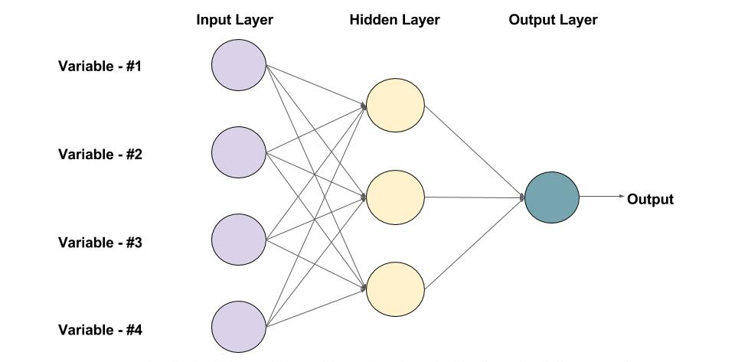

Feed Forward Neural Network
Parameter | Value
iterations | 100
learning_rate | 0.001
hidden layers | 3
random_state | 42
early_stopping | -
Standard Deep Learning Model: Used for structured/tabular data, learning complex relationships between input features.
Multiple Layers: Uses multiple hidden layers and nonlinear activation functions to model complex dependencies.
Flexible Architecture: Easily adaptable for different types of prediction tasks, from regression to classification.

Slide 8
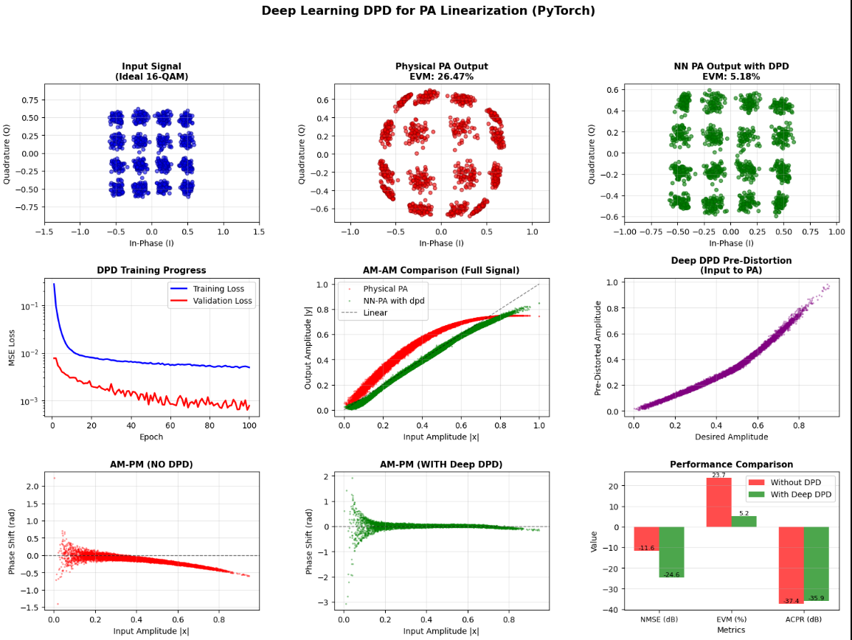
Feed Forward Neural Network
IMPROVEMENT
NMSE Improvement: 14.06 dB
EVM Improvement: 21.29 %
ACPR Improvement: -7.13 dB
Best suited for PAs with weak or negligible memory effects, such as narrowband operation or high output back-off.

Slide 9
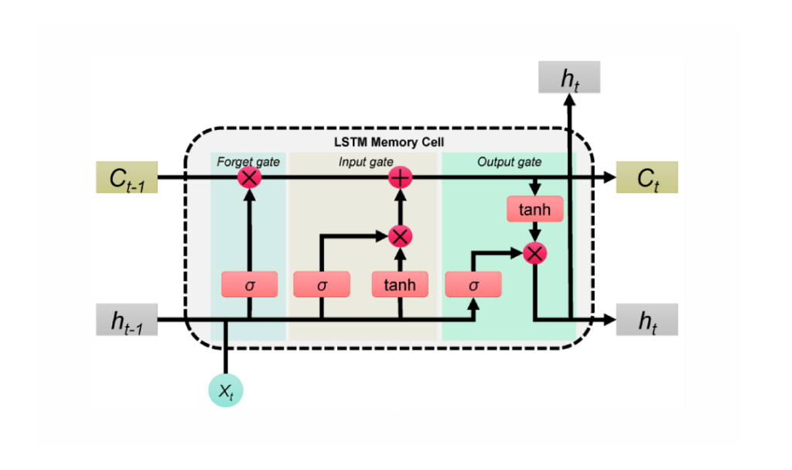
LSTM
Parameter | Value
iterations | 100
learning_rate | 0.001
hidden layers | 3
random_state | 42
early_stopping | -
Handles Irregular Time Intervals: Incorporates time gaps between observations, making it suitable for irregularly spaced data.
Enhanced Temporal Modeling: Adjusts gate calculations using time information to better capture temporal dependencies.
Ideal for Time-Series Forecasting: Particularly effective in scenarios where time intervals between data points vary.

Slide 10
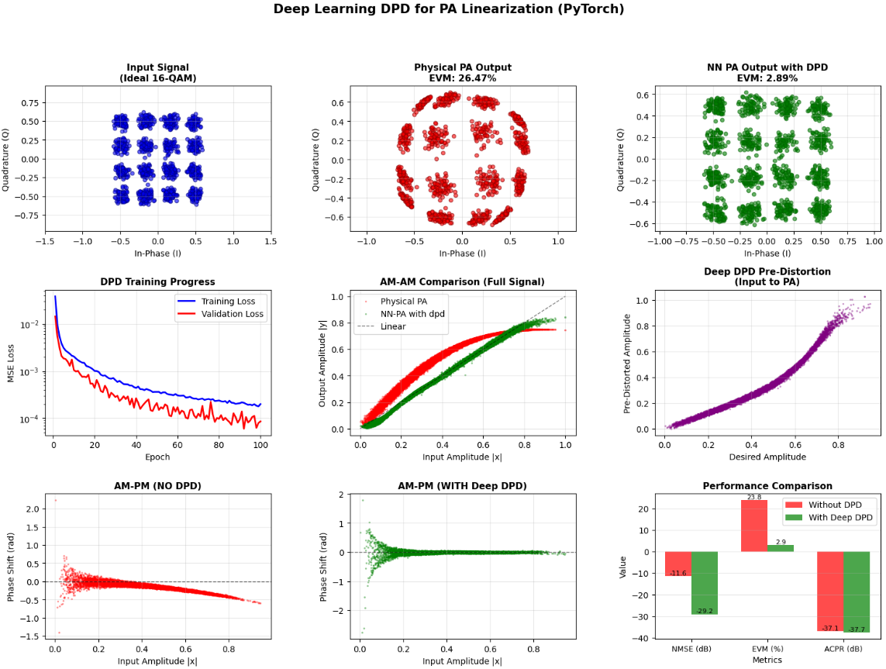
LSTM
IMPROVEMENT
NMSE Improvement: 18.59 dB
EVM Improvement: 23.58 %
ACPR Improvement: -5.34 dB
LSTM-based DPD effectively handles long-term PA memory effects but offers limited advantage over GRU given its higher complexity.
Overall, LSTM offers excellent memory modeling capability but at the expense of increased training and inference complexity.

Slide 11
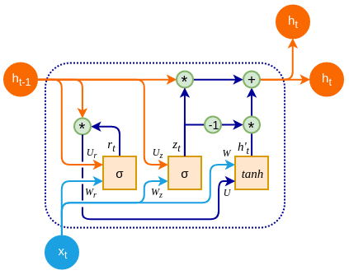
GRU
Parameter | Value
iterations | 100
learning_rate | 0.001
hidden layer | 3
random_state | 42
early_stopping | -
Simplified Recurrent Neural Network: Similar to LSTM but uses fewer gates, resulting in lower computational cost.
Update and Reset Gates: Uses these gates to effectively capture dependencies in sequential data.
Efficient for Time-Series Forecasting: Well-suited for sequential data with faster training compared to LSTMs.

Slide 12
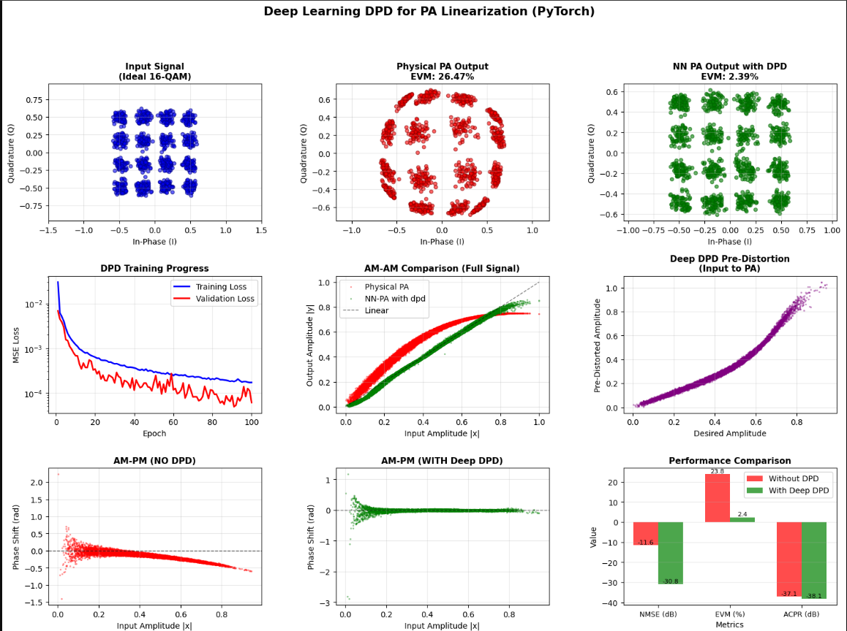
GRU
IMPROVEMENT
NMSE Improvement: 20.19 dB
EVM Improvement: 24.08 %
ACPR Improvement: -4.87 dB
Best suited for PAs with strong memory effects, including wideband signals and near-saturation operation.
Represents a practical and robust DPD architecture for real-world transmitters requiring strong linearization with manageable computational cost.

Slide 13
Comparitive Analysis
DPD Model | NMSE Improvement (dB) | EVM Improvement (%) | ACPR Improvement (dB) | Best Suited For | Major Limitation
RNN | 10.50 | 18.00 | −11.22 | Moderate memory effects | Training instability, limited long memory
FFD | 14.06 | 21.29 | −7.13 | Low-memory, narrowband PAs | Poor handling of memory effects
LSTM | 18.59 | 23.58 | −5.34 | Long-term memory effects | High complexity, slower training
GRU | 20.19 | 24.08 | −4.87 | Strong memory, wideband PAs | Slightly weaker ACPR improvement

Slide 14
Conclusion
Deep learning–based DPD significantly improves PA linearity in terms of NMSE, EVM, and ACPR for 16-QAM signals.
Feed Forward DPD is effective for low-memory PAs but fails to adequately suppress memory-induced distortion.
Recurrent architectures outperform feedforward models by explicitly modeling PA memory effects.
GRU-based DPD achieves the best overall trade-off, delivering the highest NMSE and EVM improvements with stable training and moderate complexity.
LSTM provides comparable performance to GRU but at higher computational cost, making it less attractive for practical implementations.
These results highlight that DPD architecture selection is critical and should be guided by PA memory characteristics and system constraints rather than PA modeling alone.

Slide 15


